Slide 1


Supervised Machine Learning Algorithms: A Comprehensive Guide
Embark on an illuminating journey through the intricate world of linear regression, a cornerstone of supervised machine learning algorithms. Discover its inner workings, benefits, limitations, and real-world uses.
by Pankaj Patil

Slide 2
What is Supervised Learning?
Definition
Goal
Applications
Supervised learning involves training a model on labeled data to predict outcomes for new data.
Find patterns in data to map inputs to outputs accurately.
Spam detection, predictive analytics, and image classification.

Slide 3
Linear Regression
Equation
1
Linear Regression in a Nutshell
The fundamental equation for linear regression is:
Predicts a continuous target variable by finding the best-fit line that connects the independent and dependent variables.
y = β0 + β1x + ϵ
Where y is the dependent variable, x is the independent variable, β0 is the y-intercept, β1 is the slope, and ϵ represents the error term or residuals.
2
The Fitting Process
Analyzes the data to determine the slope and intercept that minimize the distance between the predicted and actual values.
This simple linear model aims to find the best-fit line that minimizes the squared differences between the predicted and actual values. The coefficients β0 and β1 are estimated using techniques like ordinary least squares.
3
The Predictive Power
Once the line is fitted, it can be used to forecast future values of the target variable based on new independent variable inputs.

Slide 4
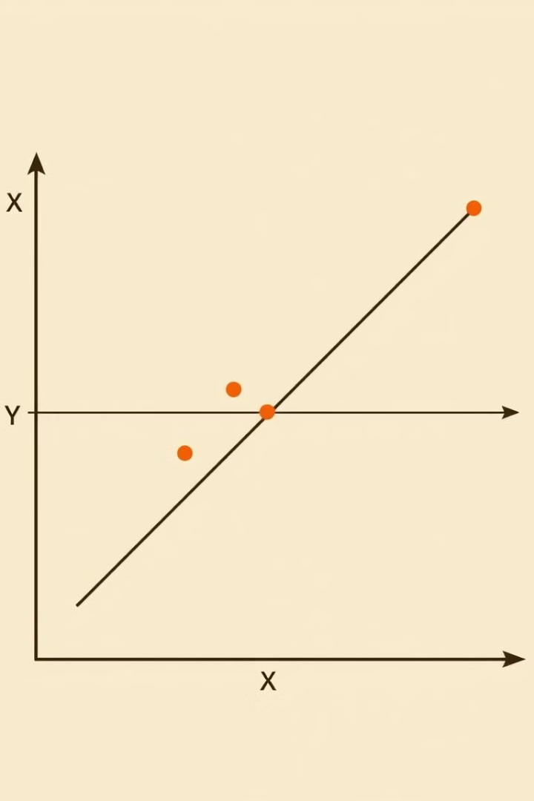
Linear Regression: Advantages and Disadvantages
Advantages
Disadvantages
Simple to implement and interpret.
Assumes a linear relationship between variables.
Computationally efficient.
Sensitive to outliers, which can disproportionately affect the model.
Works well for linearly separable data.

Slide 5
Linear Regression: Use Cases and Assumptions
Home Pricing
Linearity
Accurately predict home values by analyzing factors like location, size, and amenities.
The relationship between independent and dependent variables is linear.
Normality
Sales Forecasting
Residuals (errors) are normally distributed.
Anticipate future sales trends by correlating historical data with key business drivers.
Homoscedasticity
Economic Insights
Constant variance of errors across all levels of the independent variables.
Uncover macro-level trends by modeling relationships between economic indicators.
Multicollinearity
Independent variables should not be highly correlated.

Slide 6
Linear Regression: Underfitting, Overfitting, and Data Size Considerations
1
Avoiding Underfitting
Number of Records (Rows):
Use polynomial regression to model more complex, non-linear relationships between variables.
At least 10-20 times the number of independent variables (features) is recommended.
Preventing Overfitting
Number of Variables (Features):
2
Apply regularization techniques like Ridge or Lasso regression to prevent the model from memorizing the training data.
Works well with fewer variables. Adding too many irrelevant variables increases the risk of multicollinearity.

Slide 7
Linear Regression: Handling Outliers and Multicollinearity
Handling Outliers
Handling Multicollinearity
Highly sensitive to outliers. Consider removing or transforming them.
Multicollinearity affects the reliability of coefficient estimates. Use Variance Inflation Factor (VIF) to detect and remove highly correlated features.

Slide 8
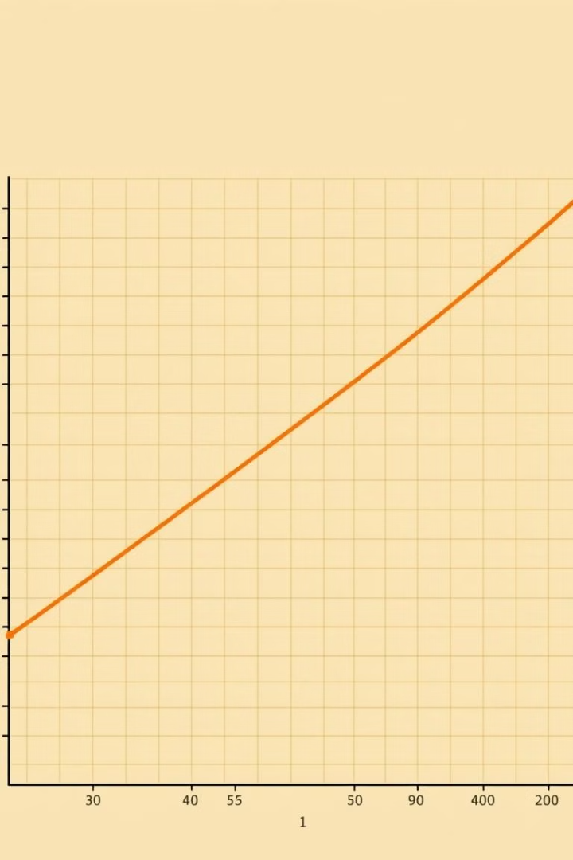
When Linear Regression Works Well
Normal Distribution
Predictive Power
Linear regression works best when the target variable is approximately normally distributed and the data meets the assumptions discussed earlier.
It's a powerful tool for understanding and predicting linear relationships in data.
Limitations
However, it's crucial to be aware of its limitations and apply it appropriately.

